Slide 1
A New Era for Roxcell Pharma
HR Management
Oracle Global HCM enterprise structure implementation

Slide 2
The Strategic Role of HR
HR drives productivity, innovation, and business growth.
Acts as a bridge between company goals and employee performance.

Slide 3
The Challenge
This project focuses on implementing a comprehensive Human Resources Management System (HRMS) for Roxcell Pharma using Oracle ERP Cloud to address HR inefficiencies and improve operations.

Slide 4
Why Roxcell Pharma needs to setup HR ERP?
Roxcell Pharma faces challenges in managing human resources due to manual processes, leading to inefficiencies in recruitment, performance management, and employee lifecycle processes.
These issues result in delays, errors, and reduced employee satisfaction.

Slide 5
The Vision
Implement an efficient Oracle HR and Payroll system for accurate processing, streamlined workflows, and enhanced employee self-service.

Slide 6
The Mission
Establish a comprehensive HR management strategy that:
Streamline HR processes including recruitment, performance, and lifecycle management.
Ensures compliance with Egyptian labor laws, social insurance, and tax regulations
Empowers employees through transparent policies and self-service options.
Enhance operational efficiency through automation and integration.
Establish an Oracle ERP Cloud-based HR system.

Slide 7
Scope of work
Enterprise structure plan.
Job and position Management.
Work force planning and reporting.
** Integrating Technology: Oracle ERP Business suite

Slide 8
Let’s explore system’s setup

Slide 9
Enterprise structure plan
enterprise’s work structure setup using Oracle HRMS Configuration reduces time, cost, and risk of ‘standard’ implementations

Slide 10
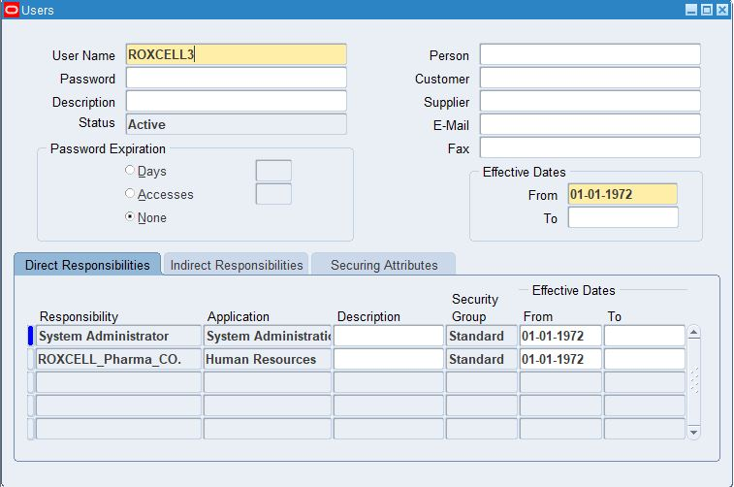
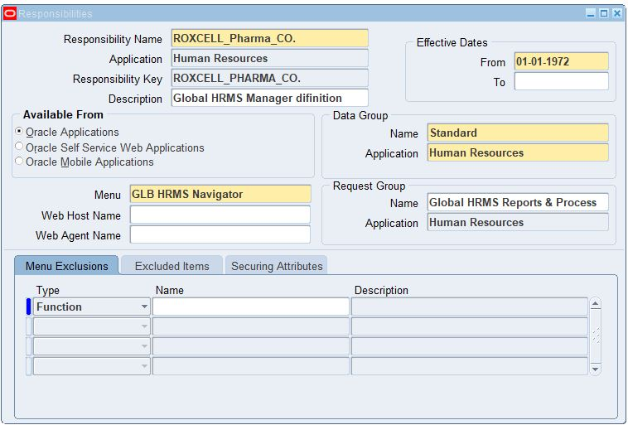
We created a user and a responsibility for the company as a starting point on Oracle.
System administrator – Security – User - Define
System administrator – Security – Responsibility- Define

Slide 11
Then we create the key flexfields which are enable us to represent the unique structure of our business organization such as jobs, positions , and grades, etc.
Key flexfields
From human resources
Job
Position
From Payroll
People group
Grade
Competence
Cost allocation

Slide 12
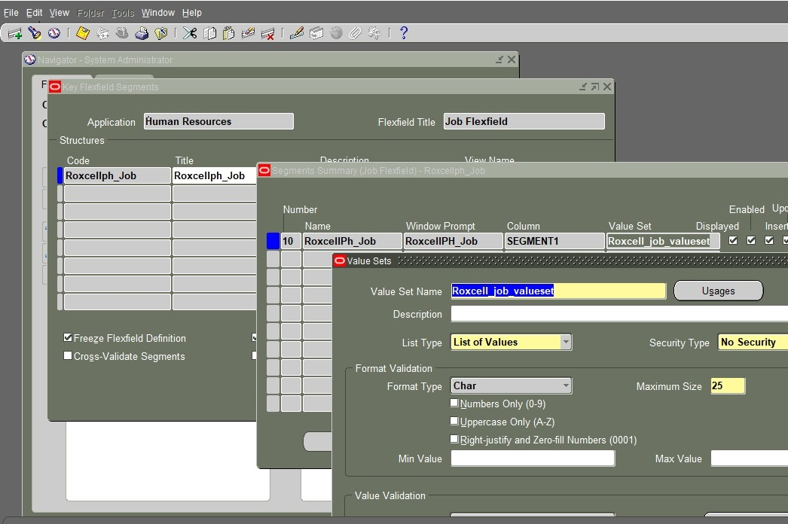
Here is the example of job key flexfield
System administrator – Application – Flexfield – Key - Segment

Slide 13
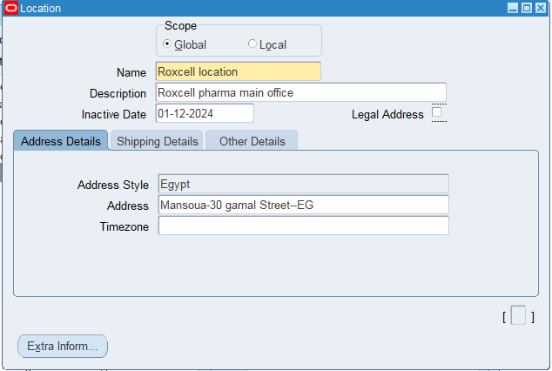
Then, I have set location for the company, which is considered its legal address.
Work structures – Location

Slide 14
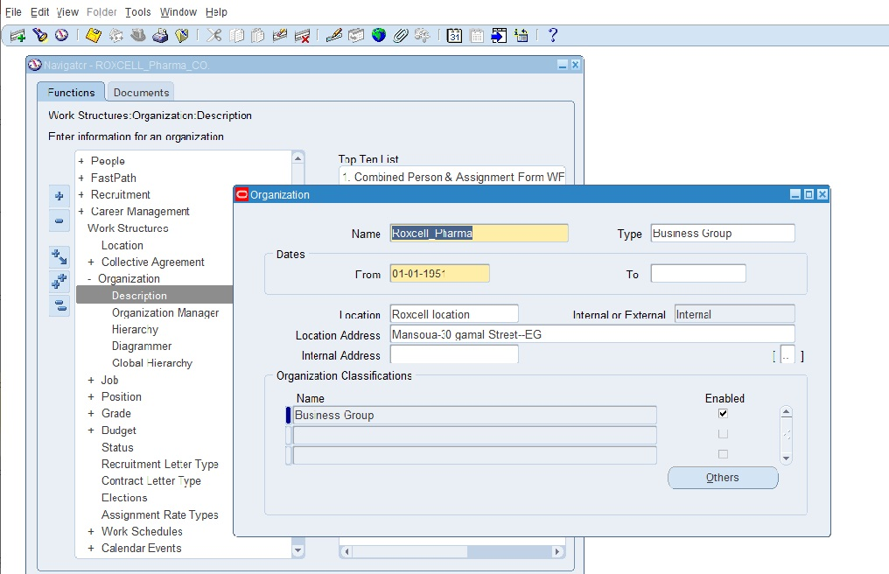
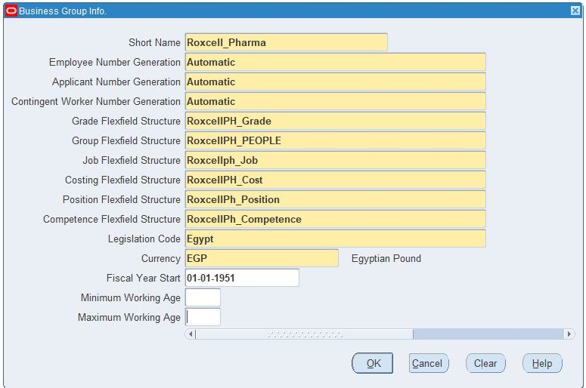
After that, I established the business group & its key flexfields
Work structures – Organization - Description

Slide 15
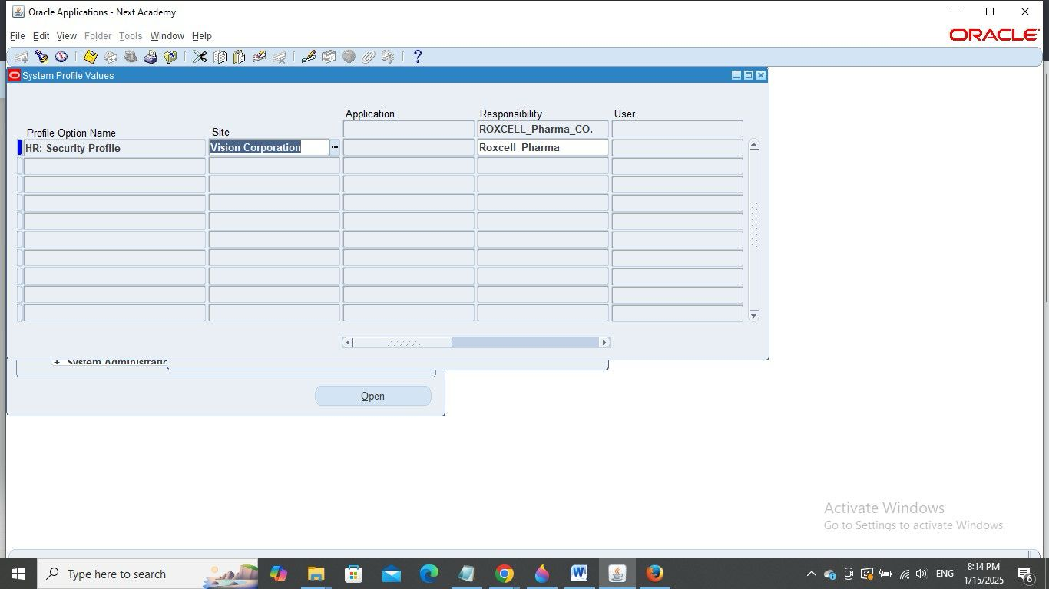

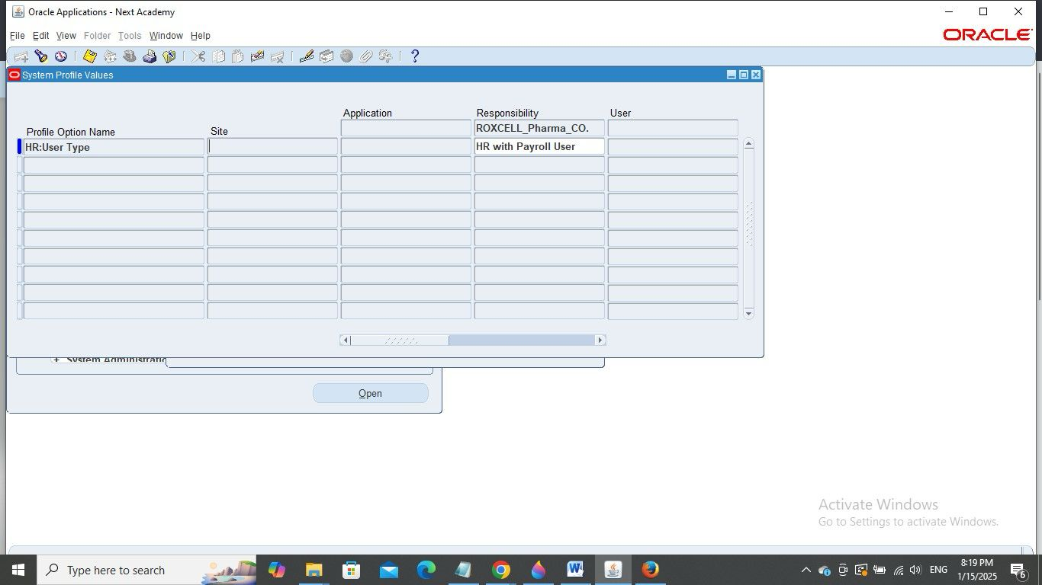
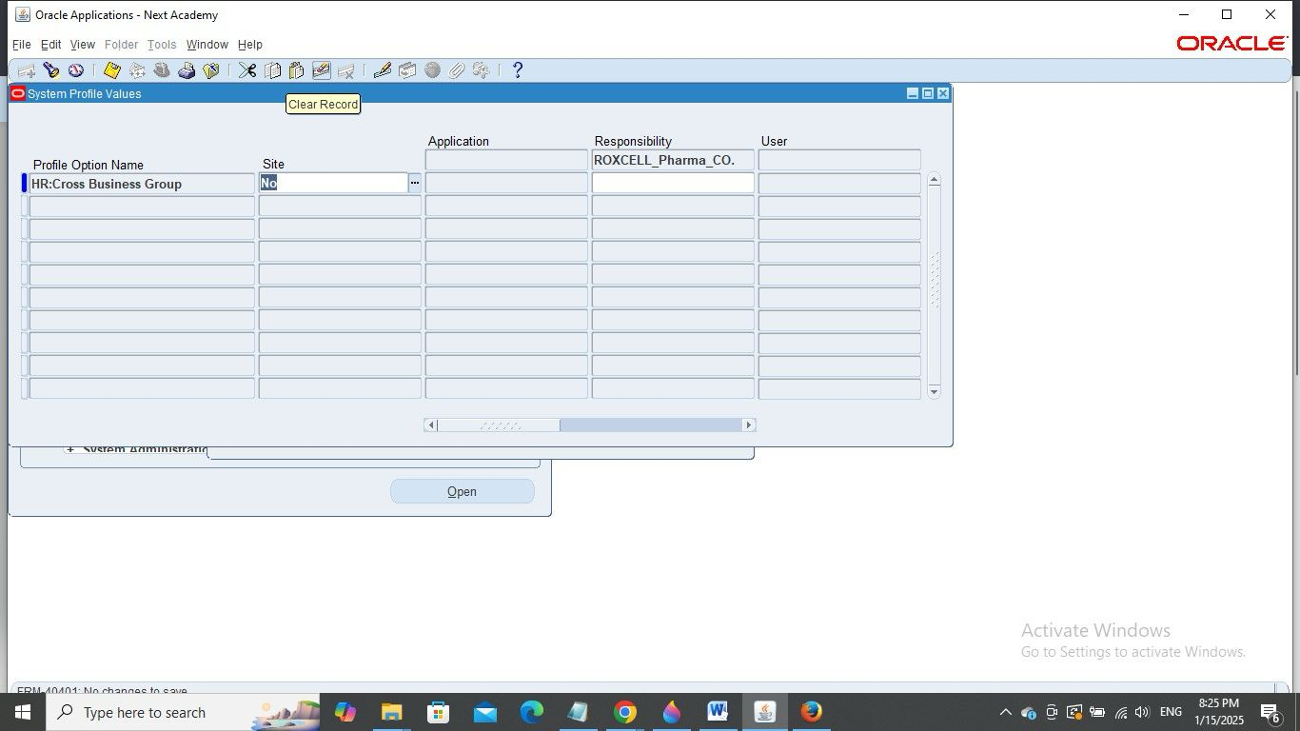
To make sure everything works smoothly, we defined the 4 security profiles.
System administrator – Profile - System

Slide 16
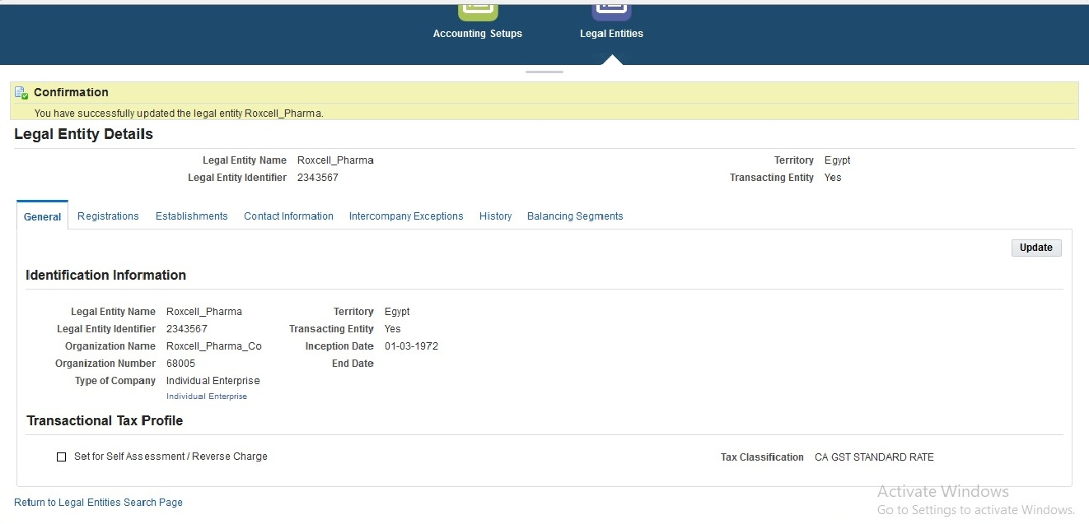
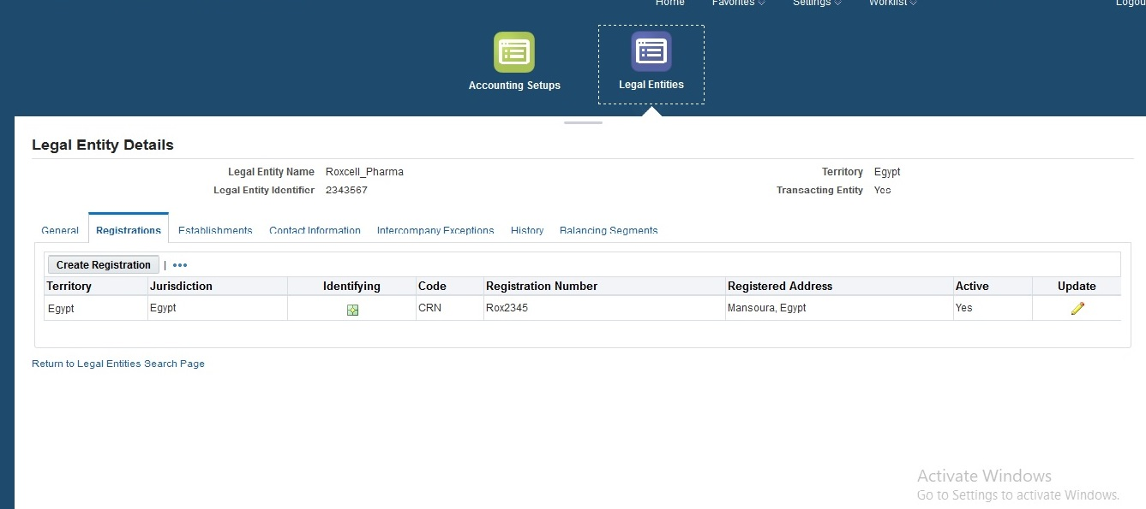
Defining & setup legal entities in Oracle HCM,
Assigning appropriate details such as tax identification numbers, legal addresses, and jurisdictions.

Slide 17
Creating business units and define their roles within the enterprise &
defining intercompany relationships.
Roxcell Pharma company
Executive Leadership
Strategic Planning
Corporate Governance
Research & Development (R&D)
Clinical Research
Administrative Support
Executive Assistants
Preclinical Research
Drug Discovery
Data Management
Study Monitoring
Sales & Marketing
Sales
Marketing
Market Research
Regional Sales
Digital Marketing
Internal
External
Premier Agency
Medical Agency

Slide 18
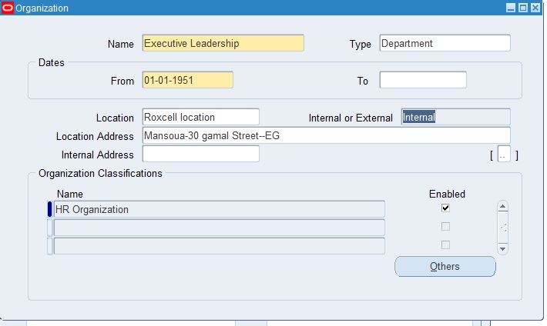
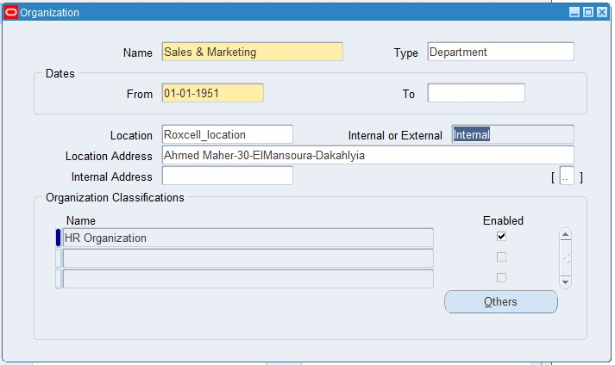
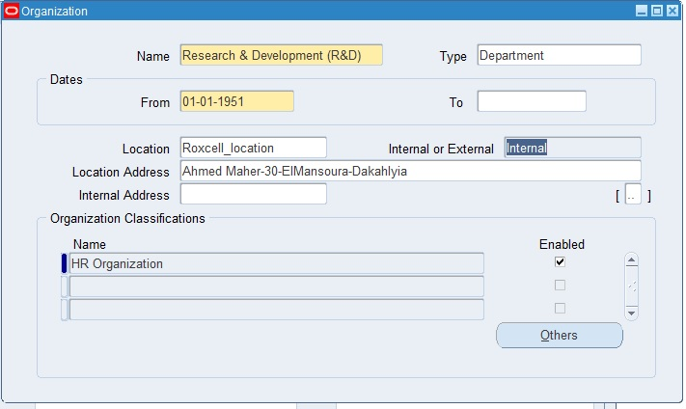
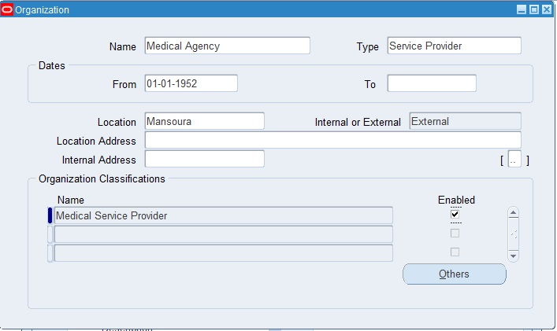
Then, we Configure Departments and Locations
Work structures – Organization - Description

Slide 19
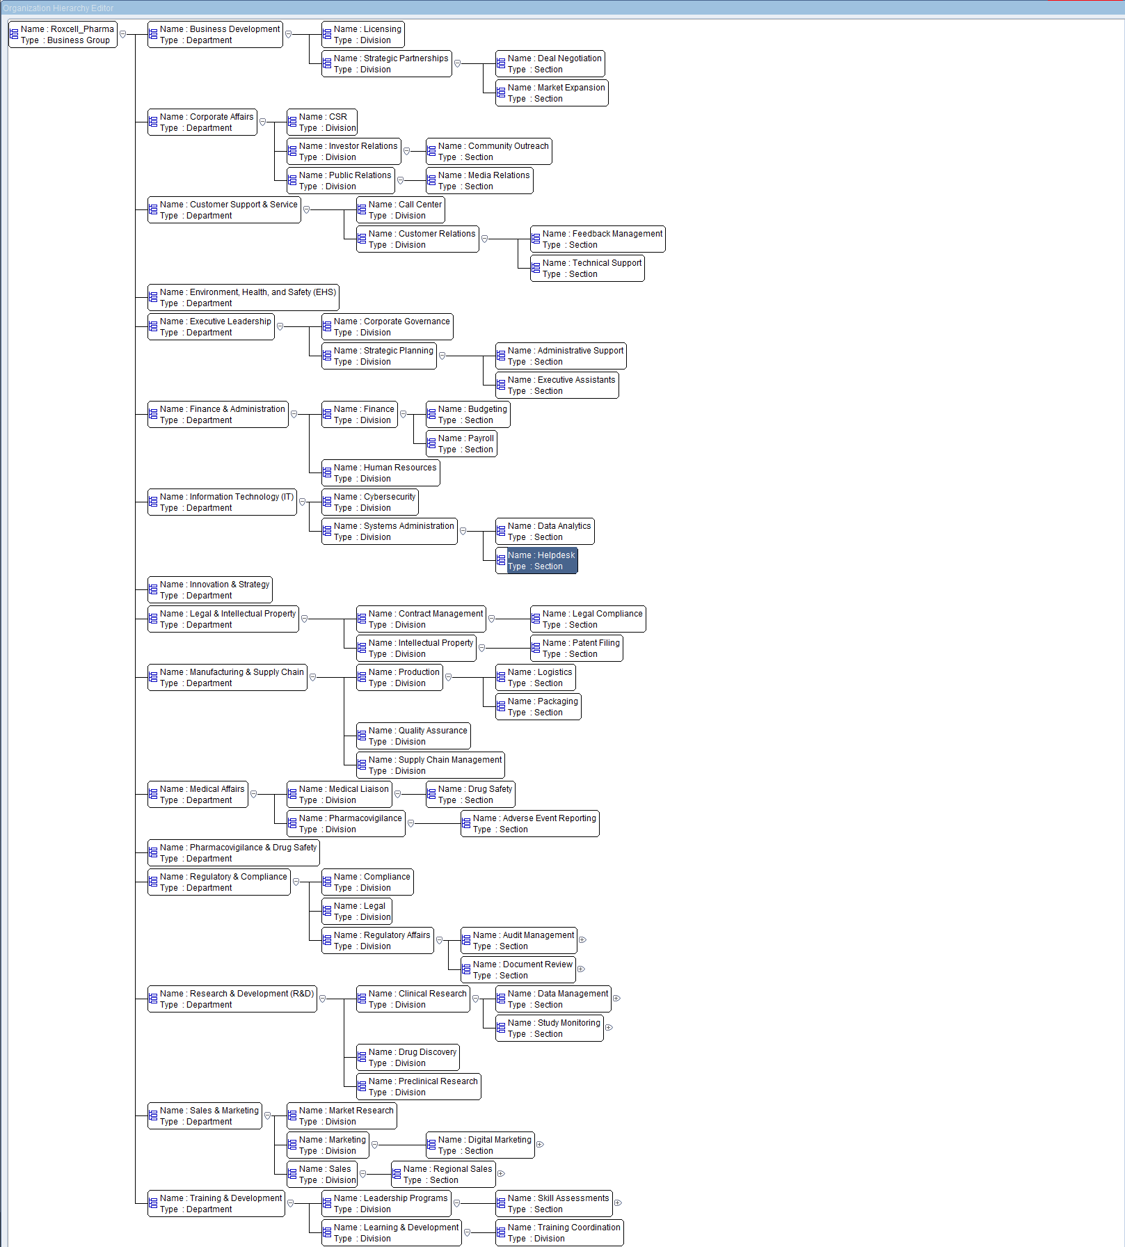
Finally, we created the organization hierarchy for the company and assigned managers and supervisors to the organization hierarchy.
Work structures – Organization - Hierarchy

Slide 20
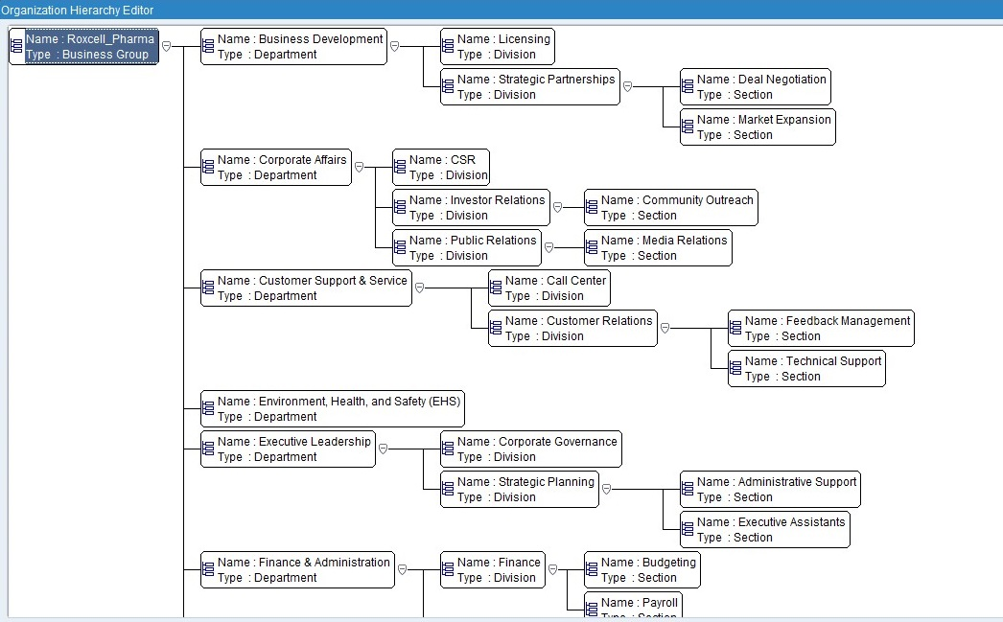

Slide 21
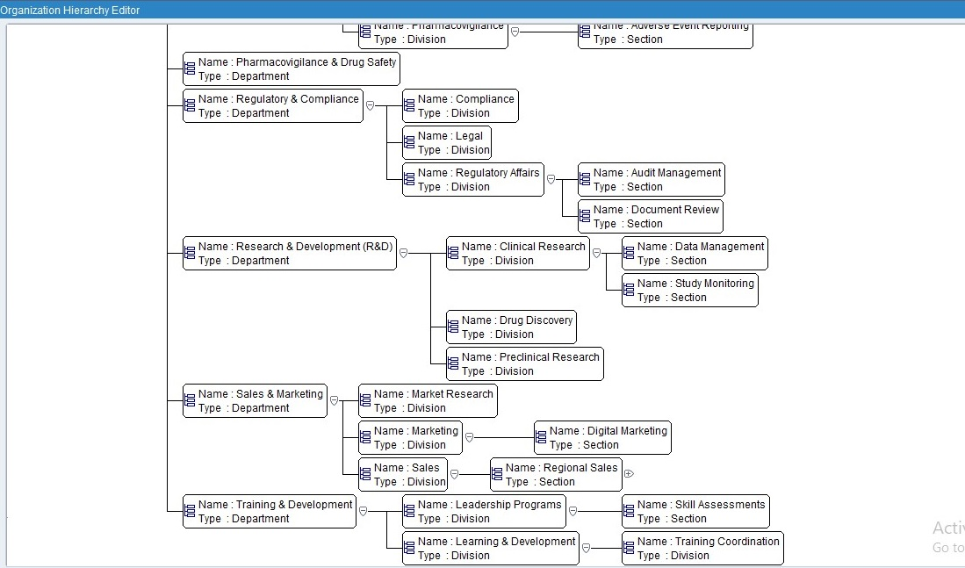

Slide 22
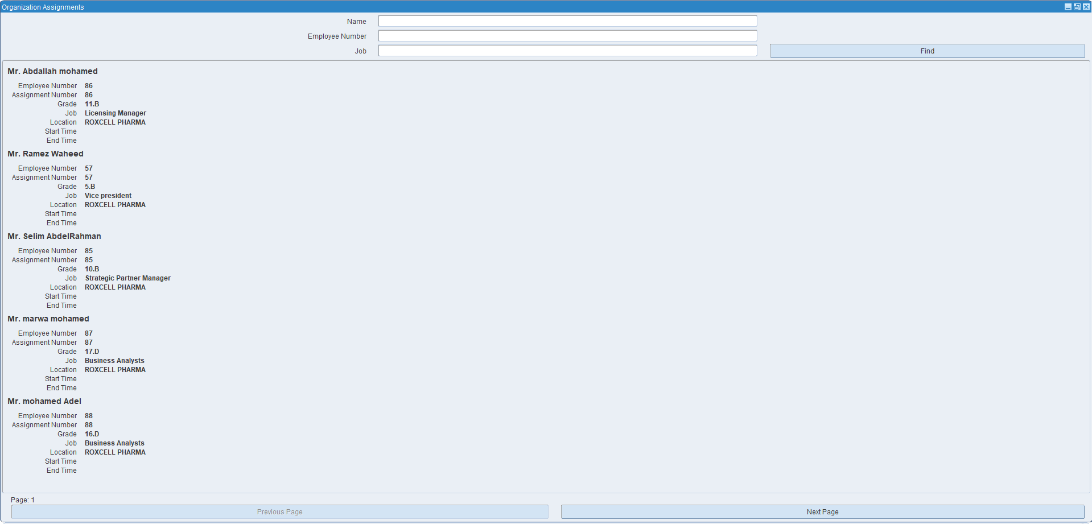
assigned managers and supervisors to the organization hierarchy.

Slide 23
Job and Position Management

Slide 24
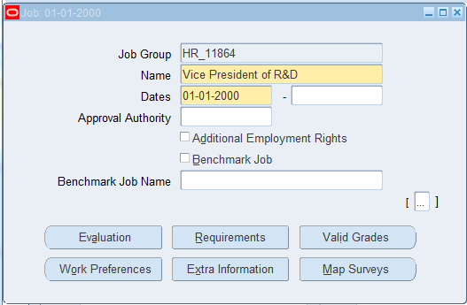
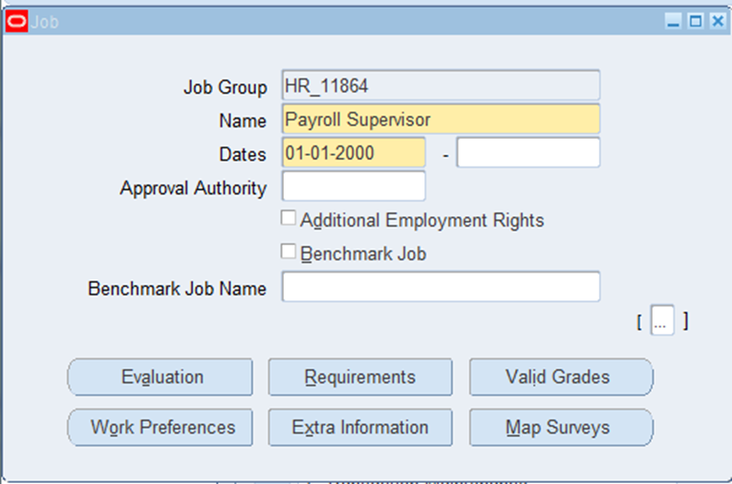
We define job roles, including titles and qualifications.
Work structure Job Description

Slide 25
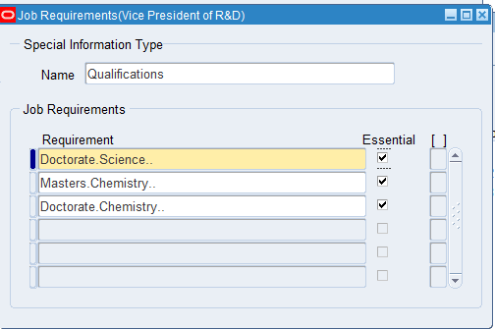
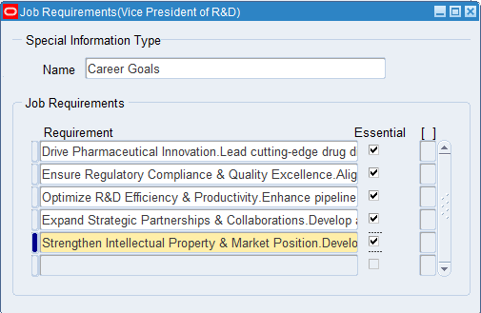
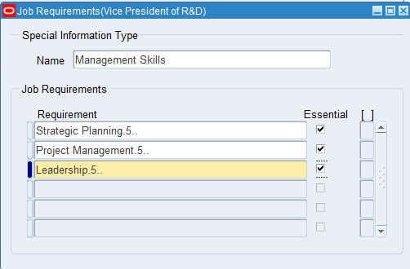
Improving human resource management
Ensuring employee alignment with company needs.
Facilitating evaluation and promotions based on employee performance and company goals..

Slide 26
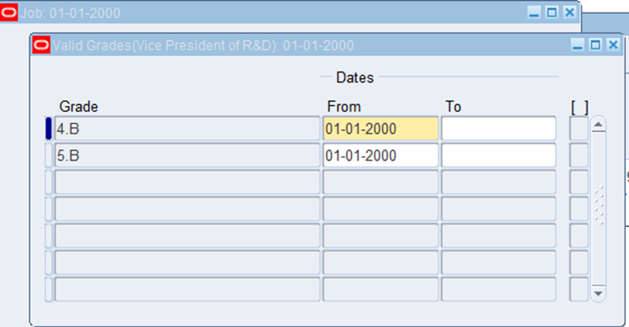
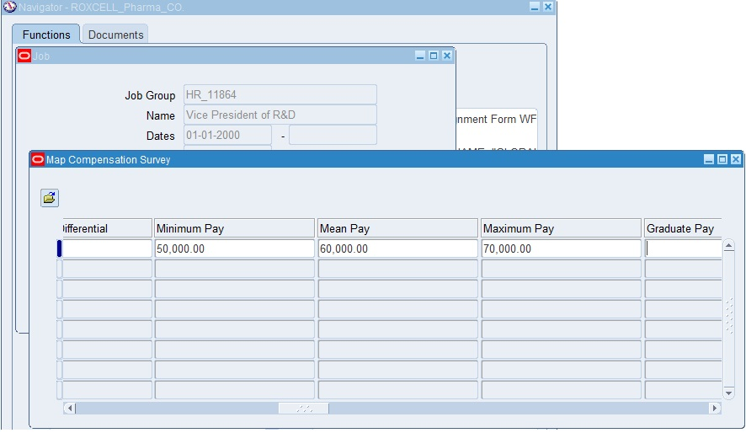
We Assign appropriate grades and compensation structures to each job role .
✅
Increase retention of talented
Employees Achieve innovation
Goals Enhance brand reputation Increase revenue
Through efficiency

Slide 27
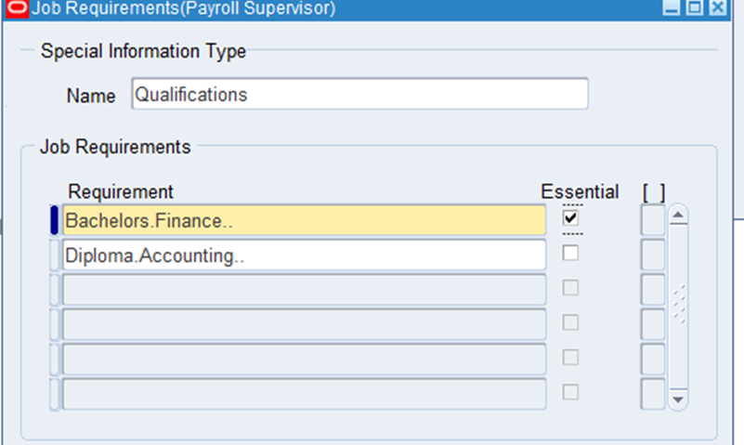
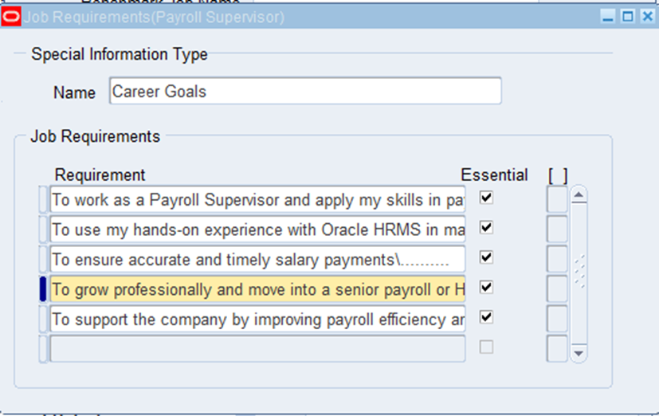
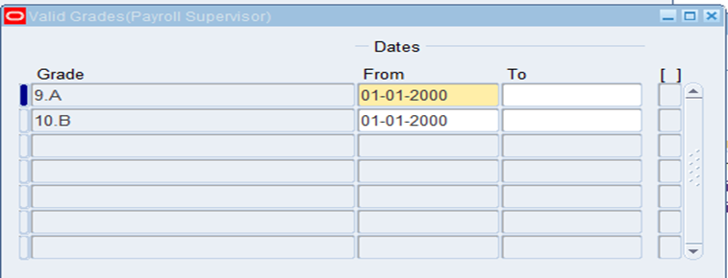
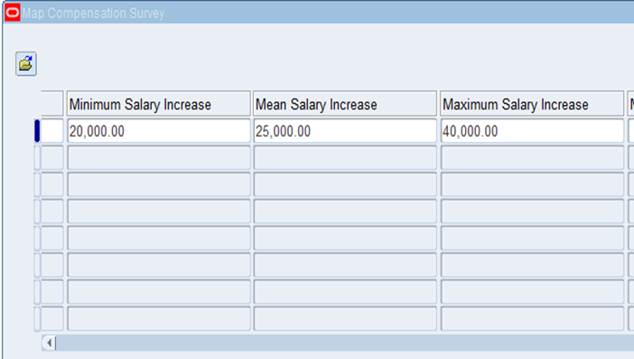
define job roles, including titles and qualifications for Payroll supervisor .

Slide 28
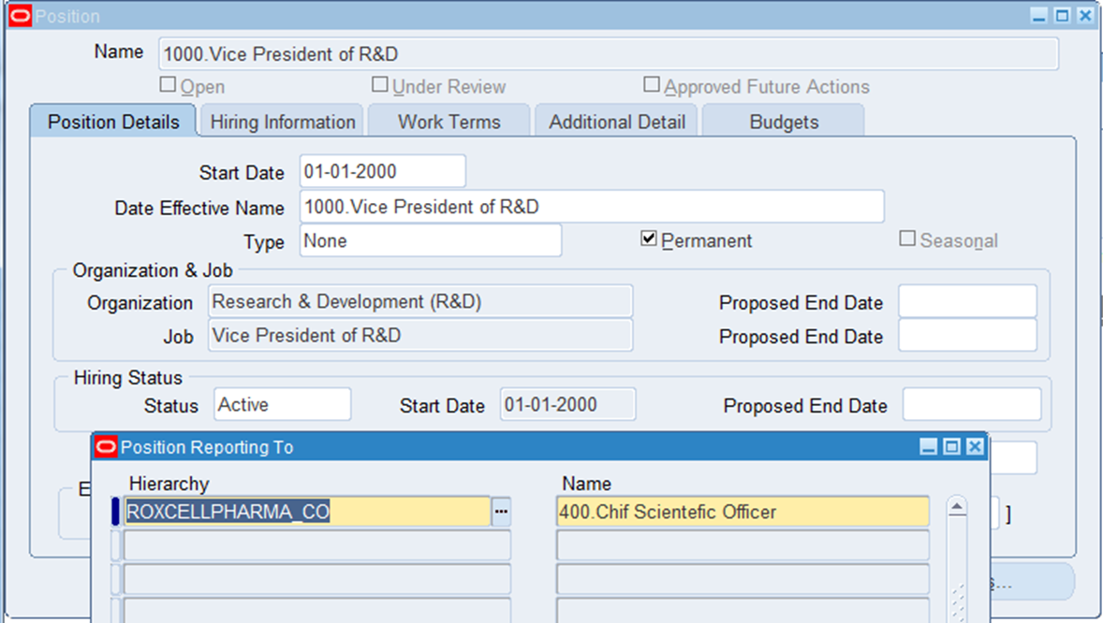
Create positions within departments and assign job roles to these positions.
Global HRMS Work structure Position Description

Slide 29
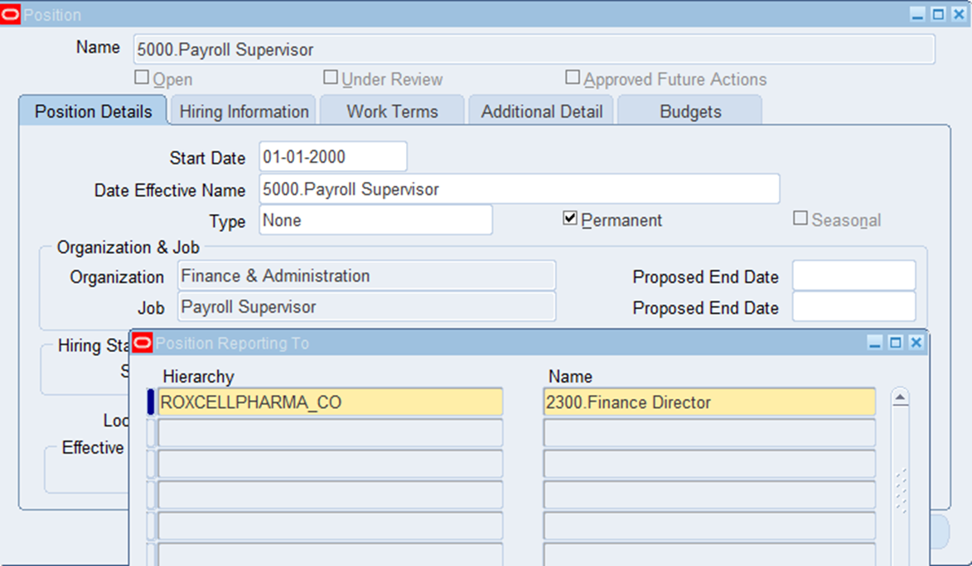
Position for payroll supervisor

Slide 30
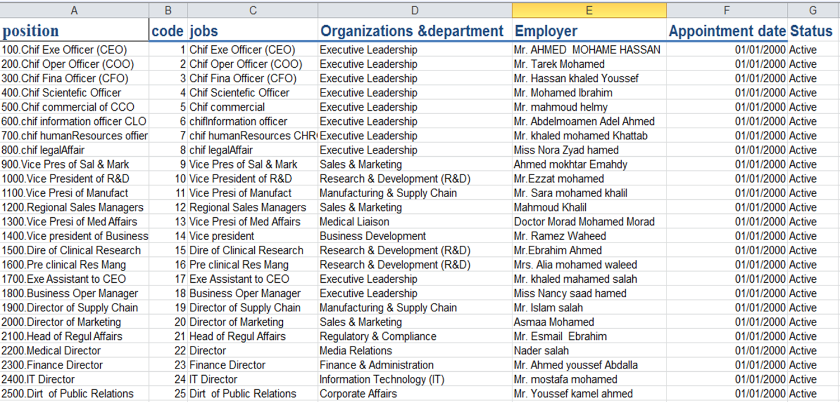
Work force MAP

Slide 31
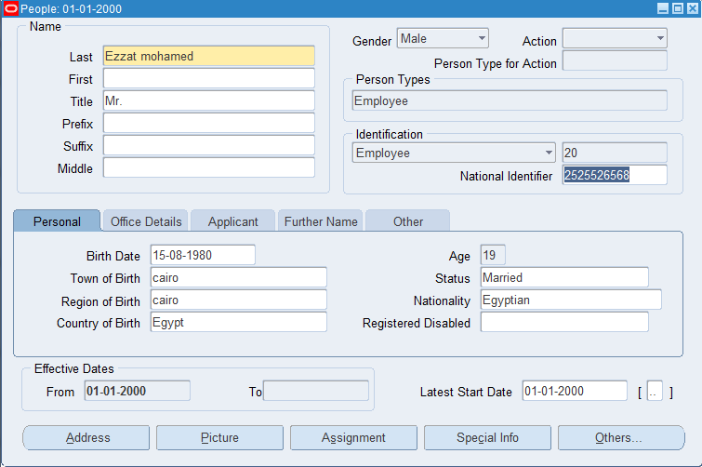
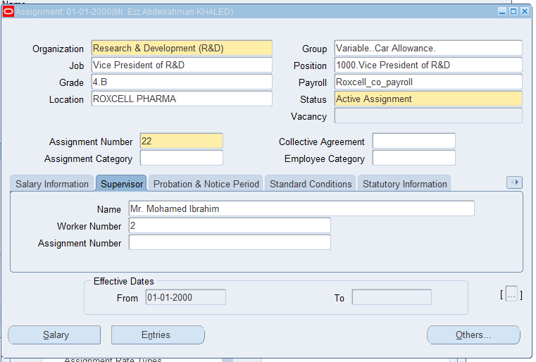
Manage workforce assignments by linking employees to the correct legal entities, business units, and departments with their supervisors
Global HRMS People Enter & maintain

Slide 32
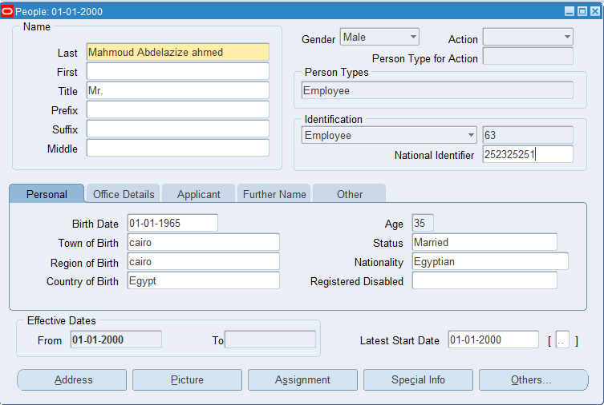
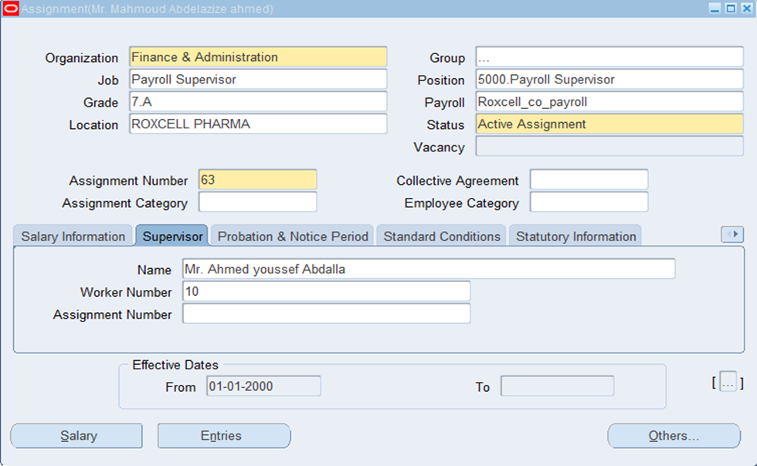

Slide 33
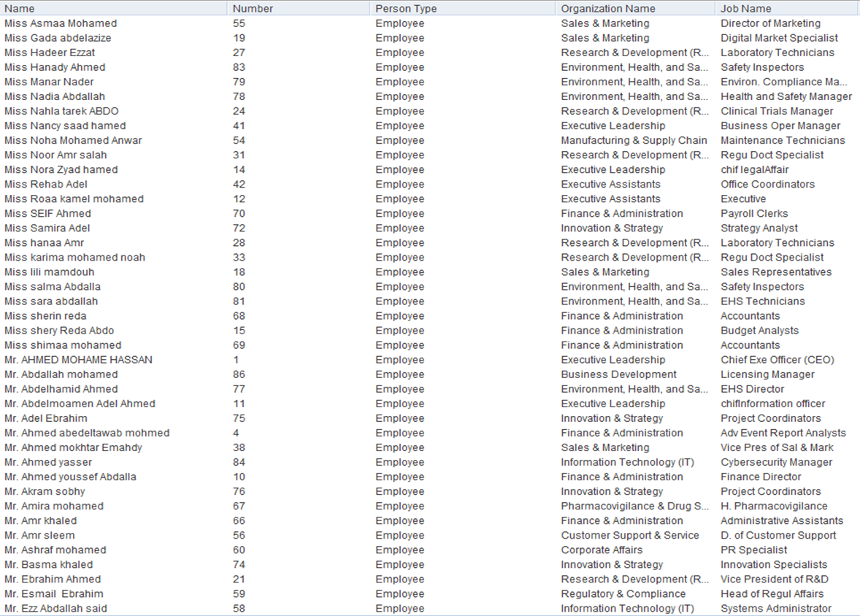
“Employee Assignments to Business Units
and Job Roles”
Global HRMS
People
Enter &
maintain

Slide 34
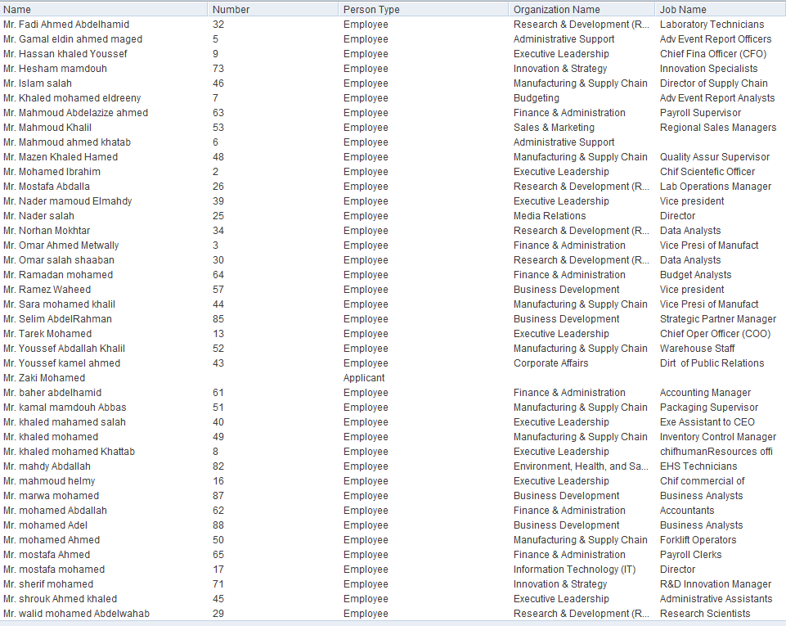
Total employee
Assigned :133

Slide 35
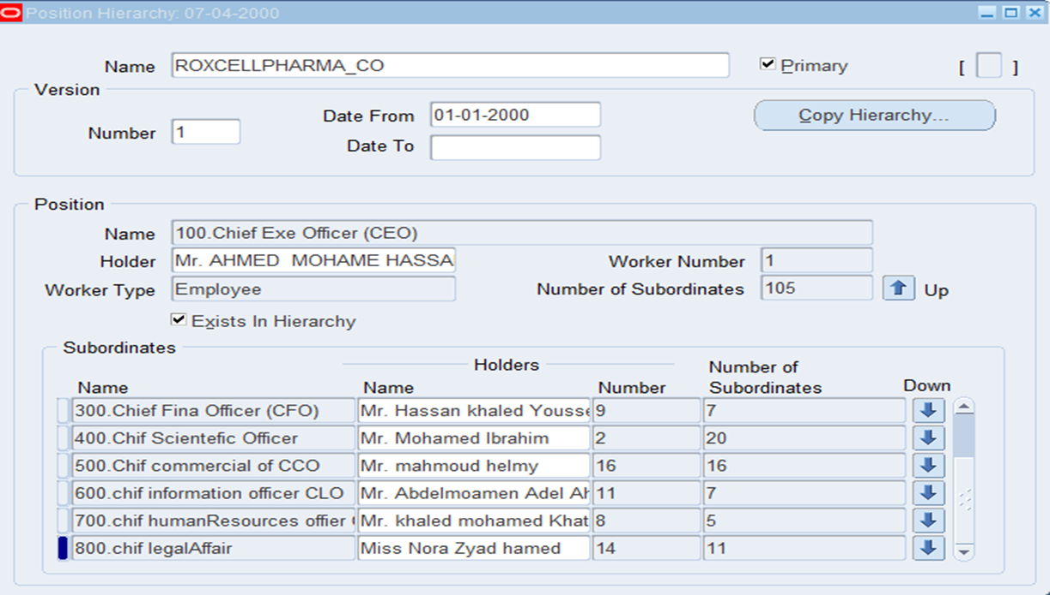
The position hierarchy of the institution shows the names of its positions and employees.
Work structure Position hierarchy

Slide 36
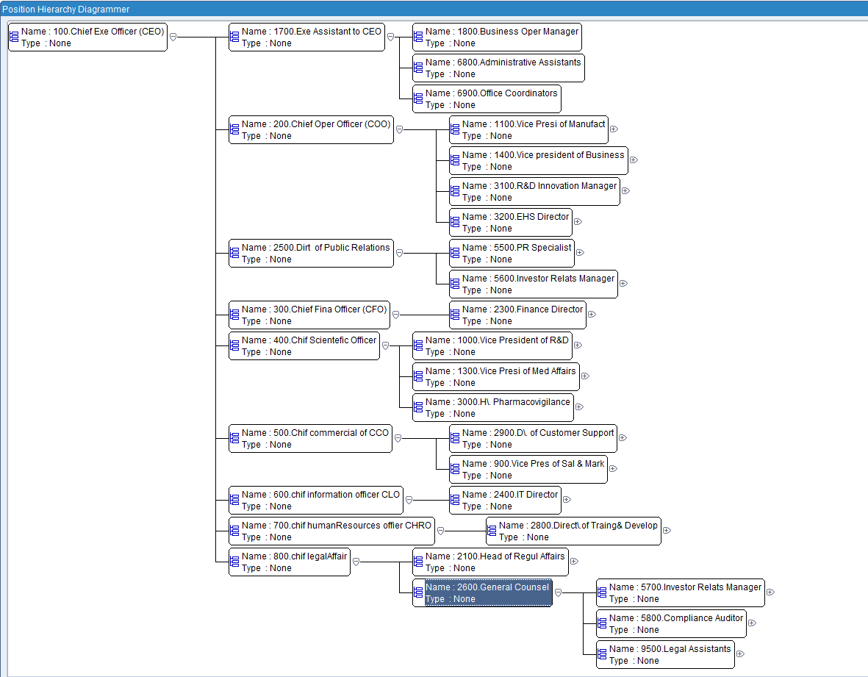
Position hierarchy defines the levels of authority and responsibility, ensuring a clear chain of command and efficient workflow.
Global HRMS
Work
structure
Position
Diagrammer

Slide 37
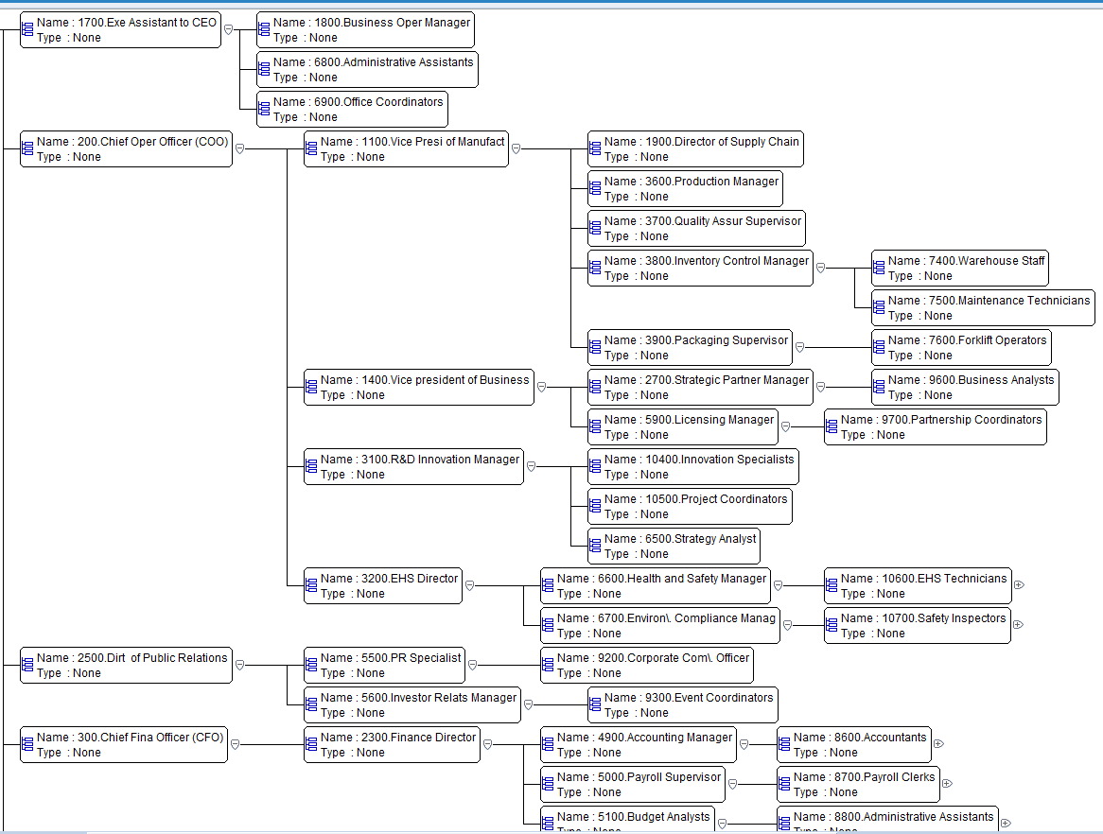

Slide 38
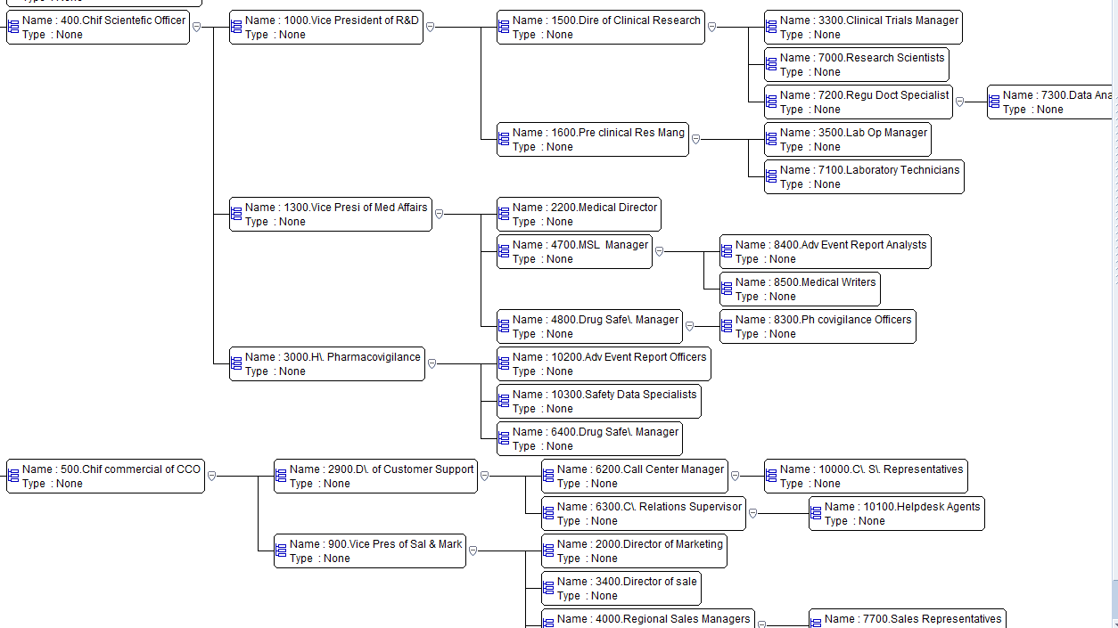

Slide 39
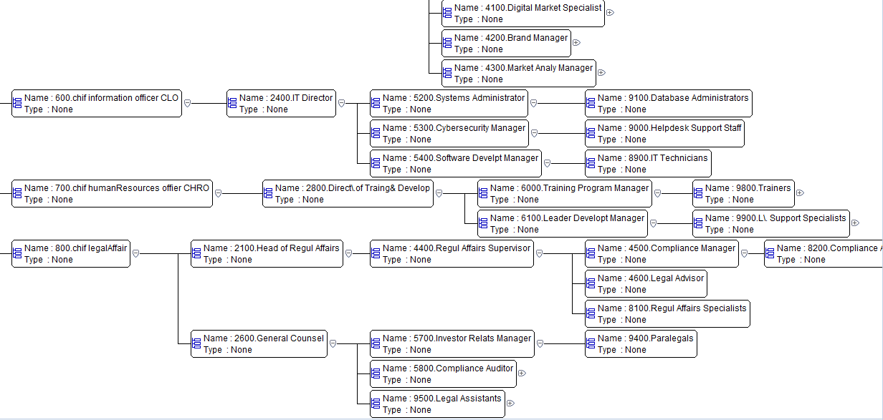

Slide 40
Workforce planning and reporting

Slide 41
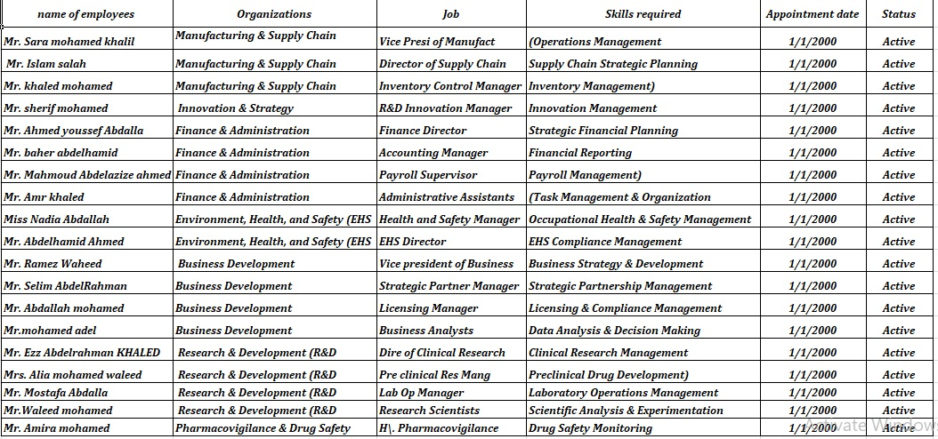
Workforce Planning
we can predict workforce needs based on current job roles and positions

Slide 42
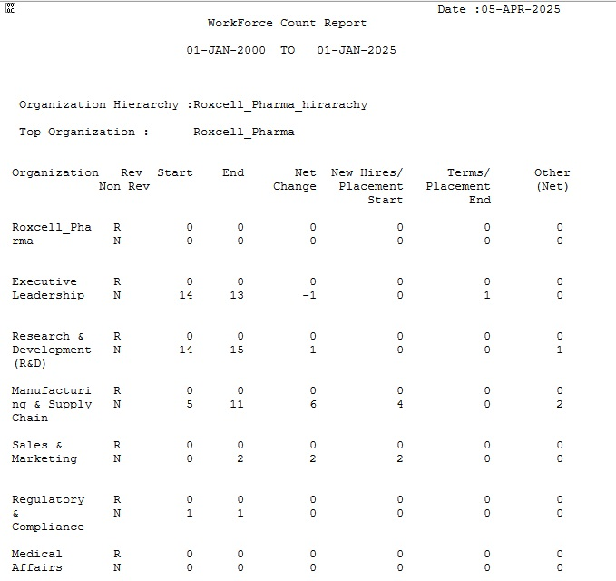
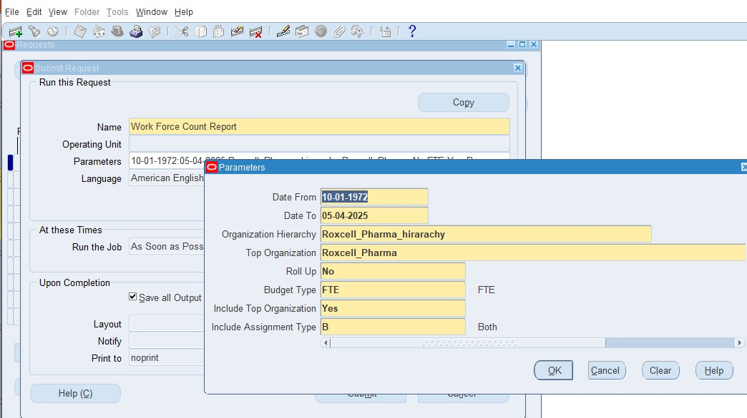
By Using Oracle HCM we can run a report from the menu bar by choosing view –request – submit a new request and choose workforce count report to illustrate forecast workforce needs based on current job roles and positions

Slide 43
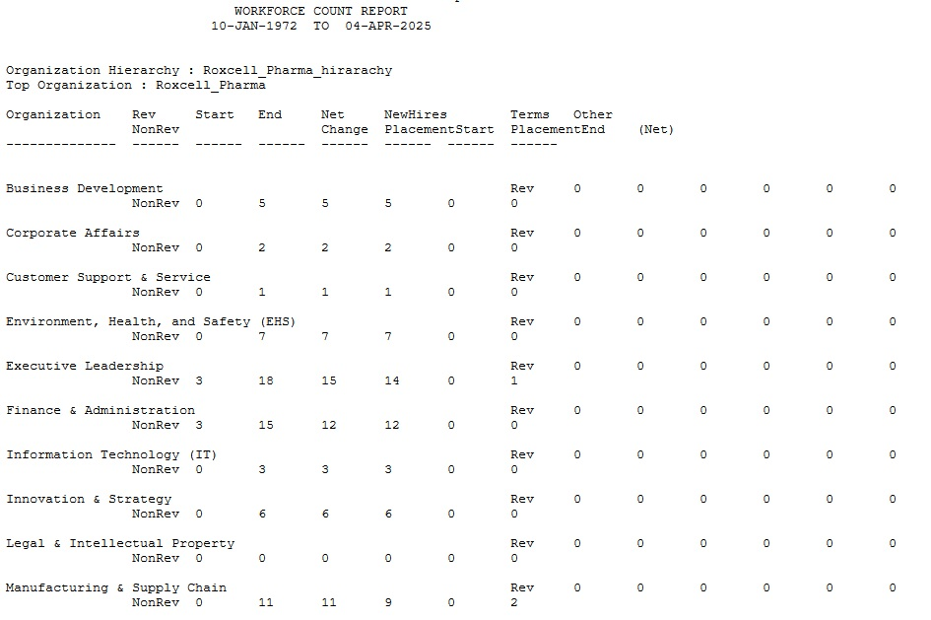
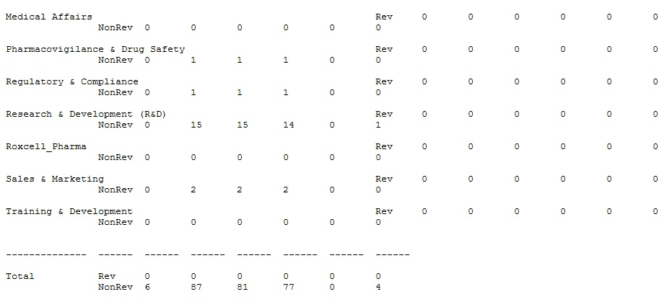
By Using Oracle HCM to forecast workforce needs based on current job roles and positions.

Slide 44
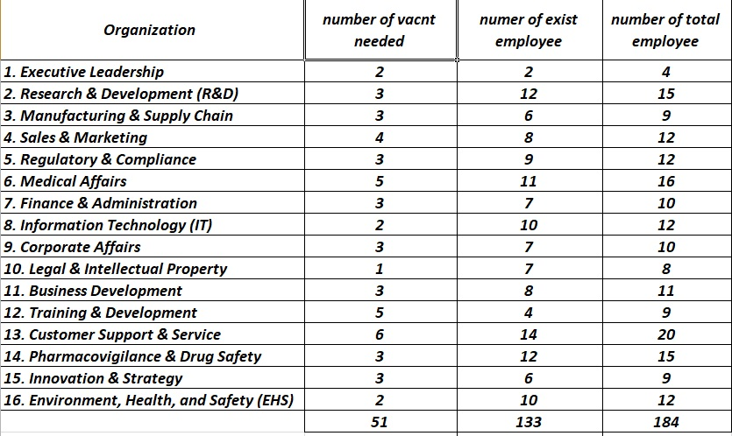

We can Identify gaps in current workforce structure and plan recruitment or internal promotions accordingly, So , we need to identify the required positions and the number of employee needed in each department

Slide 45


So we need to identify the required positions and register them on Oracle through the recruitment module
From Recruitment function - requisition and vacancy and put them on oracle

Slide 46

Then, we will collaborate with Premier agency to handle the recruitment process and hire the required employees.
we need two position for recruitment

Slide 47

we registered all the job applicants on Oracle ( from recruitment function , then choose applicant quick entry ) to make sure that all data is secure in case we need it in the future

Slide 48
After selecting the employee for hiring, we collect the required hiring documents such as:-
National ID copy.
Birth certificate.
Academic certificates.
Military status certificate.
Criminal record.
Employment record.
Social insurance statement.
and attach them to their file in the archive.

Slide 49
Talent Management Integration

Slide 50


Performance management
We can Integrate talent management features such as performance reviews and development plans with the enterprise structure by aligning the employees with the right roles for their skill levels and future career growth.
From career management function we choose competence requirements and compare it with the employee’s competence profile to make sure that they are matched with each other

Slide 51



Through Oracle, we can match required skills and jobs with employees to ensure that employees are aligned with the right roles for their skill levels and future career growth

Slide 52

but in this case we find that the employee needs more training with English languish so we give her a training course

Slide 53

The employee's skills were reviewed and it was confirmed that his English language level had been raised to the required level after he received appropriate training.

Slide 54
Generate Enterprise Structure Reports

Slide 55


We run reports to review the current enterprise structure, workforce assignments, and organizational hierarchies from menu bar we choose view then request – submit a new request – name of request such as (assignment status report , organization hierarchy , worker organization movement ) as follow

Slide 56



We can also ensure that employees are aligned with the right roles for their skill levels and future career growth.

Slide 57


We Generate Enterprise Head count Reports to review the current enterprise structure, workforce assignments, and organizational hierarchies.
The Head count Detail Report provides a comprehensive breakdown of the organization's workforce, including employee count, job roles, departments, and employment status, helping to ensure the accuracy of legal entities, business units, departments, and job roles.

Slide 58



We can use these reports to review the employees’ absence .

Slide 59

Use these reports to ensure the accuracy of legal entities, business units, departments, and job roles.

Slide 60

Use these reports to ensure the accuracy of legal entities, business units, departments, and job roles.

Slide 61
Close period and reconcile

Slide 62
Close period and reconcile
Before closing the HCM period, we must ensure that all enterprise structure data is up-to-date and accurate before closing the Human Capital Management (HCM) period by Using Oracle HCM to load enterprise structure data such as legal entities, business units, and departments with processes to ensure data integrity.
For closing the payables period, ensure that all transactions are completed and approved, including invoices and payments, then we process unaccounted invoices to ensure there are no incomplete transactions.
After closing the period, we reconcile with other modules like Financials and Payroll to ensure consistency.

Slide 63



Payroll reconciliation report
We use reconciliation reports to identify any discrepancies between different modules and update the data accordingly. This ensures that all data is consistent and updated, facilitating effective management of the organization.

Slide 64
Close period and reconcile
Reconciling Data with Other Modules such as Financials & accounts and verify balance integrity
Review reconciliations to identify any bottlenecks or potential errors.
Reconciliation with Payroll:
Finally we reconcile the enterprise structure with other modules such as Financials and Payroll for consistency
The payroll module automates salary calculations, deductions, and payments, ensuring accurate and efficient payroll processing

Slide 65
The Impact
Expected outcomes:
- Faster and error-free HR processes
- Improved employee satisfaction
- A scalable system that supports Roxcell Pharma’s growth.

Slide 66
Our great team
Aliaa Omar El-Farouk Ibrahim El-Eraky
Zainab Saad Abd El-Aziz
Zhan Abed El-Hameed EL-Dreeny
Thank you

